Slide 1
WP5: Management, Dissemination, Exploitation of results
Vincent CROS & Benoît PILORGET

Slide 2
INTRODUCTION
Objectives:
Meeting the objectives of the project within the agreed budget and timeframe and carrying out control of the milestones and deliverables
Coordinating project activities and ensuring effective internal communication
Improving the dissemination of results and external communication
Implementing the strategy for knowledge management, protection and exploitation of the results
Implementing the strategy to improve awareness of gender equality

Slide 3

Outline
Tasks
Task 5.1: Project coordination
Task 5.2: Project monitoring and risk management
Task 5.3: Improving the dissemination of the results and the external communication
Task 5.4: Strategy for the exploitation of results
Task 5.5: Measures for improving the number of female scientists within our project
Milestones
Deliverables
Further activities

Slide 4
Use of Person-Months in WP5
Person-Months spent during RP1
 | CNRS | UHAM | UNIVLEEDS | GLASGOW | JUELICH | CAU | PSI
PM spent | 7 | 0 | 0 | 0,5 | 0 | 0 | 0,8
Percentage of P-M spent
 | Planned | Actual | % realised
WP5 | 41,14 | 8,3 | 20,18

Slide 5
Task 5.1: Project coordination

Slide 6
T5.1: Timeframe and Workplan
Pre-financing
Interim Review
Check meeting
Check meeting
Final Check meeting
RP 1
(M0 to M18)
RP 2
(M19 to M36)
RP 3
(M37 to M48)
Pre-financing (33.33% of overall budget) dispatched between partners
All Milestones were reached and all Deliverables were delivered in due time

Slide 7
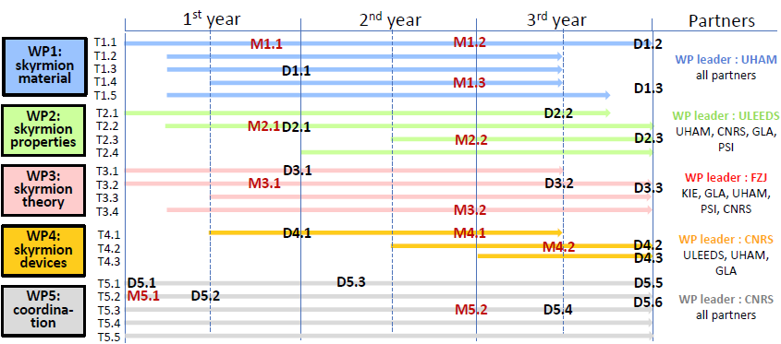
T5.1: Timeframe and Workplan
[DONE]

Slide 8
T5.1: Internal Communication
Mailing lists created:
Participants: all scientific participants in the action
Management board: Coordinator, PIs and WP leaders
Industrial Advisory Board: Coordinator and IAB members
Administration: all partners administration contact persons
Major news related to the project: meetings, workshop “save the date” message etc.
Regular discussions for strategy, document writing, publication announcements etc.
IAB meeting organisation
Send best practise advice, protocol for Check review organisation etc.

Slide 9
T5.1: Use of resources: Person-Months 1/2
Planned Person-Months per WP per Partner
 | WP1 | WP2 | WP3 | WP4 | WP5
CNRS | 15 | 22 | 12 | 22 | 22
UHAM | 62,2 | 44,2 | 23 | 17 | 6
UNIVLEEDS | 19,2 | 20,7 | 0 | 16,05 | 3,14
GLASGOW | 17,6 | 28,6 | 26 | 15,6 | 4
JUELICH | 3 | 0 | 31 | 0 | 2
CAU | 12 | 0 | 37,6 | 0 | 2
PSI | 13,05 | 17,76 | 2 | 0 | 2
TOTAL | 142,05 | 133,26 | 131,6 | 70,65 | 41,14
Actual Person-Months per WP per Partner
 | WP1 | WP2 | WP3 | WP4 | WP5
CNRS | 4 | 14 | 9 | 2 | 7
UHAM | 11 | 9,5 | 0 | 0 | 0
UNIVLEEDS | 4,08 | 9,89 | 0 | 0,92 | 0
GLASGOW | 10,82 | 1,19 | 10,75 | 0,71 | 0,5
JUELICH | 0 | 0 | 10,72 | 0 | 0
CAU | 0 | 0 | 4 | 0 | 0
PSI | 7,33 | 3,2 | 0 | 0 | 0,8
TOTAL | 37,23 | 37,78 | 34,47 | 3,63 | 8,3

Slide 10
T5.1: Use of resources: Person-Months 2/2
Person-Months per Work package
 | Planned | Actual | % Realised
WP1 | 142,05 | 47,23 | 33,25
WP2 | 133,26 | 37,78 | 28,35
WP3 | 131,6 | 24,47 | 18,59
WP4 | 70,65 | 3,63 | 5,14
WP5 | 41,14 | 8,3 | 20,18
TOTAL | 518,7 | 121,41 | 23,41%
23,41% of total Person-Months spent during year 1

Slide 11
T5.1: Use of ressources: Costs
Prefinancing amount = 45% of overall budget
 | Total budget | % total budget per partner | 1st prefinancing planned | 1st prefinancing spent |  | Percentage of prefinancing spent
CNRS | 687 018,35 € | 20,23% | 309 158,29 € | 255 506,03 € |  | 82,6%
UHAM | 606 000 € | 17,84% | 272 700,03 € | 152 046,08 € |  | 55,8%
UNIVLEEDS | 652 007,5 € | 19,20% | 293 403,41 € | 191 132,96 € |  | 65,1%
GLASGOW | 574 243,75 € | 16,91% | 258 409,72 € | 153 583,10 € |  | 59,4%
JUELICH | 318 332,5 € | 9,37% | 143 249,64 € | 89 948,63 € |  | 62,8%
CAU | 300 000 € | 8,83% | 135 000 € | 35 117,19 € |  | 26,0%
PSI | 258 837,5 € | 7,62% | 116 476,89 € | 136 444,83 € |  | 117,1%
TOTAL | 3 396 439,60 € | 100% | 1 528 398 € | 1 013 778,82 € |  | 66%
30% of total budget spent during year 1

Slide 12
Task 5.2: Project monitoring and risk management

Slide 13
T5.2: Research progress
MS10: Kick-off meeting and set-up of means for dissemination and results exploitation
D5.2: establishment of Data management Plan
KICKOFF
D5.1: Project website
M0
M1
M2
M6
HAMBURG
MS1: Room temperature stabilization of individual skyrmions
MS4: First devices available for topological transport measurements
D1,1, D2,1, D3,1, D3.1, D4.1
AACHEN
M10
M11
M12
MS6: Formation of single skyrmions in designed interface induced chiral systems
MS8: Design and nanofabrication of proof-of-principles skyrmion based devices

Slide 14
T5.2: Project monitoring
Month1: Kick-off meeting
Month 6: Progress meeting in Hamburg
Month 11: Progress meeting in Aachen
Month 14: 1st Industrial Advisory Board meeting in Paris with all WP leading partners represented
Consortium agreement: 7th and final round over, document should be signed very soon
Three Management Board meetings in one year

Slide 15
Task 5.2: Risk management
Risk # | Description of Risk | Workpackages involved | Proposes risk mitigation measures
Risk1 | To obtain MML systems with sufficiently large interfacial chiral interactions at RT. This risk is very low/medium due to experience of partners and preliminary results (see Fig.4) | WP1-WP3-WP4 | Different MML stacking will be grown in different locations and using different growth techniques: atomic layer deposition, sputtering. Engineering of anisotropies (ion im-plantation) and improved interface properties will tune the crucial parameters (J, DM, K) allowing RT skyrmion stability.
Risk2 | To achieve room temperature stability of individual skyrmions. This risk is low/medium for same reasons as Risk 1. | WP1-WP3-WP4 | Thermal stability in multilayers allows stabilization of columnar skyrmion corresponding to larger magnetic volume. Material engineering with artificial defects to improve stability. Theoretical investigation of thermal stability as function of the number of layers
Risk3 | To obtain reproducible skyrmion nucleation and deletion. Risk is medium/high attenuated by our recent micromagnetic simulations. | WP2-WP3-WP4 | Different options will be investigated: spin injection, field pulse. Design optimisation of artificial defects to facilitate the nucleation.
Risk4 | To achieve efficient skyrmion propagation by spin transfer. This risk is medium/high. | WP2-WP3-WP4 | Strong theoretical and numerical support Test on skyrmions of different size. Several sources of torques: spin-orbit torques or STT torques from conventional spin polarizers.
Risk5 | To detect the presence or the motion of single skyrmions by electrical means. This risk is low | WP2-WP3-WP4 | Different physical mechanisms are envisaged: THE, AMR, TMR. Use of magnetic sensor based on tunnel junction.

Slide 16
Task 5.3: Improving the dissemination of the results and the external communication

Slide 17
T5.3: internal and external communication
Website (http://magicsky-fet.eu)
Built and hosted by CNRS IT
Web Manager = Project manager
Biggest communication and dissemination tool
Total 6925 views on the website (date: 07-10-2016)
‘Project management’: Private section available to project participants with documentation and project results
‘Scientific results’: links to OA repository for publications acknowledging MAGicSky
‘Young Project Researchers and PhD students’: 14 biographies displayed
Twitter (https://twitter.com/MagicskyF)
59 tweets (date: 07-10-2016) mostly to communicate website articles
56 followers (date: 07-10-2016)
Target = Research Community & Technology watchers

Slide 18
T5.3: Communication & Dissemination activities
Participation in international conferences and workshops : APS, MMM and other events
Participation to FEAT matchmaking event in Amsterdam between projects and selected artists
Writing of a collaborative communication text
A few press release available on the website
66 participations from MAGicSKy participants in one year
No match for MAGicSky unfortunately
But new ideas emerged which might be implemented
By MAGicSky PhD students, PostDocs and Project Manager
Available on the website
Reusable for future press release and diverse communication actions

Slide 19
T5.3: High impact publications
18 publications acknowledging MAGicSky to this day (published articles and articles in review altogether)
Publications in high impact journals
Ex.1: Perpendicular reading of single confined magnetic skyrmions;
D. Crum et al.; Nature Communications, October 2015
Ex.2: Additive interfacial chiral interaction in multilayers for stabilization
of small individual skyrmion at room temperature; C. Moreau-Luchaire
et al.; Nature Nanotechnology; January 2016
Ex. 3: Engineering skyrmions in transition-metal multilayers for
spintronics; B. Dupé et al.; Nature Communications; June 2016
Attention Score of 32
Attention Score of 26
In the top 5% of all research outputs scored by Altmetric
Attention score of 125
Notes:
-Website= regularly updated and hosted by the CNRS -> biggest tool for dissemination
-Dissemination to the physics research community: 66 participitations from MAgicSKy participants in one year.
High impact journals: 18 publications acknowledging MAGicSky support to this day -> published articles and articles in review altogether
Example: Additive interfacial chiral interaction in multilayers for stabilization of small individual skyrmion at room temperature, Nature Nanotechnology
In the top 5% of all research outputs scored by Altmetric
Magicsky is part of the Commission pilot project for openaccess: peer-reviewed publications and their related data must be available in openaccess
Done thanks to Openaire and Zenodo websites, supported by the Commission

Slide 20
T5.3: Open Access
LINKAGE
https://www.openaire.eu/
DATA
http://zenodo.org/
POST-PRINT
http://arxiv.org/
https://hal.archives-ouvertes.fr/
OPENACCESS
JOURNAL
Max 6months embargo
All peer-reviewed publications and their related data must be available in openaccess
Process described in the data Management Plan
Other OA data: image galery of skyrmions, Spin-orbit properties tables in ultra-thin magnetic films, Electronic structures at transition metal interfaces (or pseudo-potentials to derive them)
All other data is a priori confidential

Slide 21
T5.3: Targeted audiences
Communication and Dissemination costs during RP1: about 46 500€
Target | Nr of persons reached
Scientific Community (Higher Education, Research) | 12500
Industry | 226
Civil Society | 0
General Public | 3227
Policy Makers | 20
Media | 75
Investors | 0
Customers | 0
Other | 6500
Clicks on website

Slide 22
Task 5.4: Strategy for the exploitation of results

Slide 23
Task 5.4: Strategy for exploitation of results
Protection of Intellectual Property: NDA, Active policy on patent filling
Plan for exploitation of results to be established by mid-2018
Find the means to define and improve the exploitation of the results is regularly discussed between partners, notably in each Management board meetings
What IP should be protected ?
How to improve potential interests from the industrial end users? In which sector?
1st meeting with the Industrial Advisory Board meeting organized in Paris on Oct, 10th
General overview of the project and presentation of our results
Discussions and advices from the IAB for improving the assessment for potential future industrial users about the application potential of MAGicSky.

Slide 24



Task 5.4: Strategy for exploitation of results
Consultation for new FET Proactive topics
“Spin - orbitronics and topology in magnetism and spintronics”
A novel direction called Spin-Orbitronics exploits the relativistic Spin-Orbit (SO) interactions and opens fascinating new roads for basic research and new line of technologies, in which European Industries can take back the lead harnessing on the strength of the European academic research in this emerging topic with strong international competition.
This SO coupling, that is the relativistic correction to the equation of quantum physics can be significantly strong in materials or systems containing heavy atoms and lead to new interesting phenomena :
The SO interactions are at the origin of a category of effects allowing an efficient conversions between charge and spin currents. Typical examples of SO effects are the spin Hall effect (SHE) (or Anomalous Hall effect in magnetic materials) by which a charge current can be converted into a transverse spin current and the inverse spin Hall effect (ISHE) for the inverse conversion. Such effects have already some technological relevance, for example with MRAMs of the 3-Terminal SO-MRAM type or the SO controlled DW based race track memory. Very recently, it it has been proved that a more efficient charge-spin conversion can be obtained by exploiting the SOC-induced properties of a two-dimensional electron gas (2DEG) at some surfaces and interfaces, the so-called Rashba interfaces and the surfaces or interfaces of new materials called topological insulators (TIs).
Another fascinating property of SO interaction is that it can be exploited to engineer magnetic materials in which new types of topological objects, such as the chiral domain walls or magnetic skyrmions can be stabilized. For example, it is anticipated that the topological protection of magnetic skyrmions should enhance their thermal stability that have a tunable dimension in the nm range, and consequently allow an easy manipulation by very small currents densities.
Combining these different spin-orbit related phenomena can lead to new and efficient ways for manipulating the magnetization in highly integrated spintronic devices with promising perspectives for the development a new generation of low power reconfigurable spintronic storage and/or logic devices.
https://ec.europa.eu/futurium/en/content/spin-orbitronics-and-topology-development-new-generation-low-power-reconfigurable-spintronic
MAGicSky : IAB Meeting – Paris, France – October 10, 2016
Slide 24

Slide 25

SpinTronicFactory
Novel Ideas for Spintronic and Magnonic Applications
Paolo Bortolotti
http://magnetism.eu/spintronicfactory

Slide 26

Task 5.4: SpinTronicFactory network -- missions
Main objectives of the MoU:
Increase industrial impact of spintronic applications in EU
Develop synergies among KETs and different H2020 programs (FET, NMBP, ICT, ITN)
Create links with other industrial networks as for example EFFRA, AENEAS, EMA, etc.
Build new synergies among partners and potential consortia for future EU calls
Improve visibility of spintronics in EU and work on the related dissemination
4 identified priority themes
(and at least 1 more new potential axe)
Radio-frequency and
microwave devices
Molecular
spintronics
PT2
Memories
PT4
PT1
PT3
PT5
Logic
Devices
Magnetic
sensors

Slide 27
Task 5.4: SpinTronicFactory network -- missions
Priority themes
Transverse themes
Pillar 1: Memories Leaders: - Stuart Parkin (MPI, Germany) - Kevin Garello (IMEC, Belgium) - Lucian Prejbeanu (CEA/SPINTEC, France)
Pillar 2: Magnetic sensors Leaders: - Paulo Freitas (INL, Portugal) - Claude Fermon (CEA/SPEC, France) - Marco Doms (SENSITEC, Germany) - Wolfgang Raberg (INFINEON, Germany)
Pillar 3: Radio-frequency and microwave devices Leaders: - Ursula Ebels (CEA/SPINTEC, France) - Sergej Demokritov (WWU, Germany) - Johan Åkerman (NANOSC, Sweden)
Pillar 4: Logic and non-Boolean devices Leaders: - Andrij Chumak (UNIKL, Germany) - Christoph Adelmann (IMEC, Belgium) - Abdelmadjid Anane (CNRS, France)
Transverse Theme 1: Advanced Materials and Fabrication Processes Leaders: - Claudia Felser (MPI, Germany) - Berthold Ocker (SINGULUS, Germany) - Stephane Mangin (UL, France)
Transverse Theme 2: Design and Modelling Leaders: - Massimiliano d’Acquino (Univ. PARTHENOPE, Italy) - Guillaume Prenat (CEA/SPINTEC, France) - Luis Lopez Diaz (Univ. Salamanca, Spain)

Slide 28
Task 5.5: Measures for improving the number of female scientists within our project

Slide 29
T5.5: gender equality
Awareness by project partners
Quote from the kick-off meeting minutes:
“To clarify the status of recruitment and update the webpage, it is best if partners send to the coordination team a biography and the status of the people hired on the project. When recruiting, (Vincent Cros) reminded that improving the gender issues is one of the subtasks in WP5. (Julia Tepel) reminds the partners that the recruitment procedures must be transparent and based on merit.”
Attention to gender equality in workshop Scientific Committee and Invited Speakers

Slide 30
Milestones
MS number | Due date | Lead Beneficiary | Name | Means of verification
Milestone 10 | Month 2 | CNRS | Kick-off meeting and set up of means for dissemination and results exploitation | Kick-off meeting organised and minutes of meeting available
Milestone 11 | Month 24 | CNRS | Workshop organisation | Workshop booklet available

Slide 31
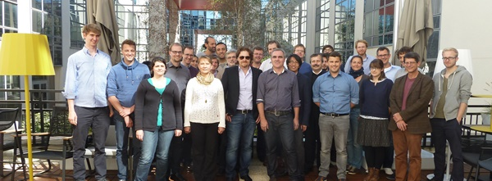
Milestones
Milestone 10: Kick-off meeting organised in Massy, on the 28-29 September 2015
Web article published on the project website on the 27-10-2015
Minutes of the meeting were sent to the Project Officer on the 04-11-2015
[DONE]
Milestone 11: SKYMAG 2 workshop will take place in Paris on the 2-5 May 2017
Venue booked
First communication actions were taken: web article and tweet written, project participants warned

Slide 32
Deliverables
Deliverable number | Deliverable title | Type | Dissemination level | Due date
D5.1 | Project website | Websites, patents filling etc. | Public | 2
D5.2 | Establishment of data management plan | Report | Confidential | 6
D5.3 | Hosting Check RP1 | Other | Confidential | 15
D5.4 | Minutes of the consortium workshop | Report | Confidential | 30
D5.5 | Final plan for dissemination and exploitation of results | Report | Confidential | 36
D5.6 | Hosting Check RP2 | Other | Confidential | 36
Lead Beneficiary:

Slide 33
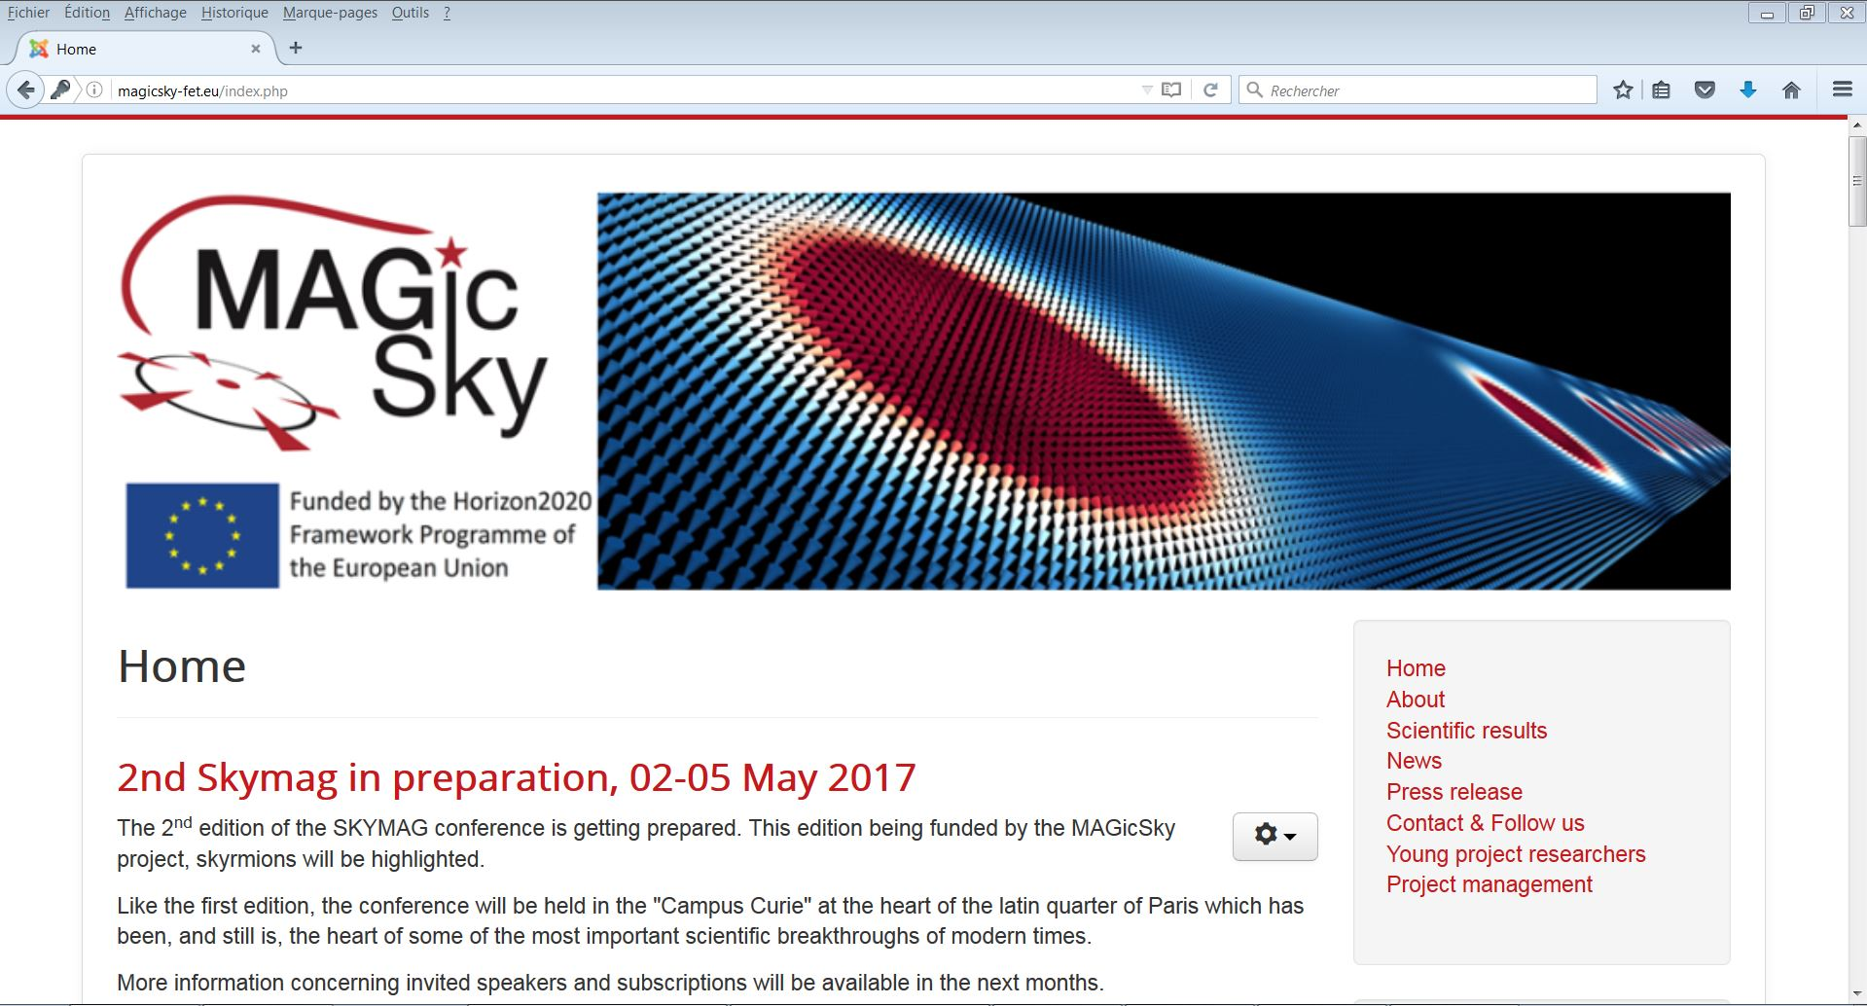
Deliverables
D5.1: Project Website, Month 2
http://magicsky-fet.eu
Domain names bought
Developed by CNRS IT service
Hosted on a CNRS server in France
Private menu item with all project documentation
Managed and Updated by the coordinator
[DONE]

Slide 34
Deliverables
D5.2: Establishment of DMP, due M6
Table of contents:
Project information
Data responsibility
Necessary resources for implementation
Data sets
Data storage, access & security
Data after MAGicSky
[DONE]
Information from the GA
Description of produced data in the project (by Site leaders)
Description of open access process
Description of items for UHAM, PSI and UNIVLEEDS
To be thought through

Slide 35


Further activities
Hosting check for RP1
Update DMP and continue to follow the OA policy
Disseminate the “Spirit Code” (Modular C++ code for numerical optimizations and dynamics simulations of atomistic spin systems – providing live visualisations during simulations)
Development of Spintronic factory
Next progress meetings
Second IAB meeting

Slide 36
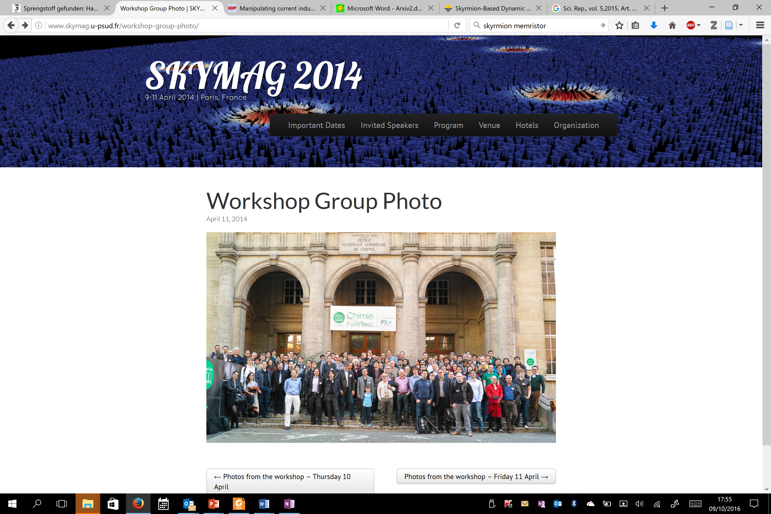

Further activities
Challenges for magnetic skyrmions and opportunities for skyrmionic devices
Paris 2-5 May, 2017
SKYMAG 2017

Slide 37
Thank you for your attention

